Slide 1
Data Preprocessing
萬宸維

Slide 2
Function Definition
Data Loading
Data Exploration
Data Cleaning
Feature Engineering
Feature Selection
Feature Scaling, Standardization
Data Splitting
PCA Applying

Slide 3
Dataset Introduction
Dataset of Red Wine Quality
fixed acidity
volatile acidity
citric acid
residual sugar
chlorides
free sulfur dioxide
total sulfur dioxide
density
pH
sulphates
alcohol
quality

Slide 4
Dataset Introduction
Dataset of Red Wine Quality
fixed acidity
volatile acidity
citric acid
residual sugar
chlorides
free sulfur dioxide
total sulfur dioxide
density
pH
sulphates
alcohol
quality
X: Features
Y: Target

Slide 5
Dataset Introduction
Raw Data: winequality-red.csv
"fixed acidity";"volatile acidity";"citric acid";"residual sugar";"chlorides";"free sulfur dioxide";"total sulfur dioxide";"density";"pH";"sulphates";"alcohol";"quality"
7.4;0.7;0;1.9;0.076;11;34;0.9978;3.51;0.56;9.4;5
7.8;0.88;0;2.6;0.098;25;67;0.9968;3.2;0.68;9.8;5
7.8;0.76;0.04;2.3;0.092;15;54;0.997;3.26;0.65;9.8;5
11.2;0.28;0.56;1.9;0.075;17;60;0.998;3.16;0.58;9.8;6
7.4;0.7;0;1.9;0.076;11;34;0.9978;3.51;0.56;9.4;5
7.4;0.66;0;1.8;0.075;13;40;0.9978;3.51;0.56;9.4;5
7.9;0.6;0.06;1.6;0.069;15;59;0.9964;3.3;0.46;9.4;5
7.3;0.65;0;1.2;0.065;15;21;0.9946;3.39;0.47;10;7
7.8;0.58;0.02;2;0.073;9;18;0.9968;3.36;0.57;9.5;7
7.5;0.5;0.36;6.1;0.071;17;102;0.9978;3.35;0.8;10.5;5
6.7;0.58;0.08;1.8;0.097;15;65;0.9959;3.28;0.54;9.2;5
7.5;0.5;0.36;6.1;0.071;17;102;0.9978;3.35;0.8;10.5;5
5.6;0.615;0;1.6;0.089;16;59;0.9943;3.58;0.52;9.9;5
7.8;0.61;0.29;1.6;0.114;9;29;0.9974;3.26;1.56;9.1;5
8.9;0.62;0.18;3.8;0.176;52;145;0.9986;3.16;0.88;9.2;5
8.9;0.62;0.19;3.9;0.17;51;148;0.9986;3.17;0.93;9.2;5
8.5;0.28;0.56;1.8;0.092;35;103;0.9969;3.3;0.75;10.5;7
8.1;0.56;0.28;1.7;0.368;16;56;0.9968;3.11;1.28;9.3;5
7.4;0.59;0.08;4.4;0.086;6;29;0.9974;3.38;0.5;9;4
7.9;0.32;0.51;1.8;0.341;17;56;0.9969;3.04;1.08;9.2;6
8.9;0.22;0.48;1.8;0.077;29;60;0.9968;3.39;0.53;9.4;6
7.6;0.39;0.31;2.3;0.082;23;71;0.9982;3.52;0.65;9.7;5
7.9;0.43;0.21;1.6;0.106;10;37;0.9966;3.17;0.91;9.5;5
...

Slide 6
Dataset Introduction
Raw Data: winequality-red.csv
"fixed acidity";"volatile acidity";"citric acid";"residual sugar";"chlorides";"free sulfur dioxide";"total sulfur dioxide";"density";"pH";"sulphates";"alcohol";"quality"
7.4;0.7;0;1.9;0.076;11;34;0.9978;3.51;0.56;9.4;5
7.8;0.88;0;2.6;0.098;25;67;0.9968;3.2;0.68;9.8;5
7.8;0.76;0.04;2.3;0.092;15;54;0.997;3.26;0.65;9.8;5
11.2;0.28;0.56;1.9;0.075;17;60;0.998;3.16;0.58;9.8;6
7.4;0.7;0;1.9;0.076;11;34;0.9978;3.51;0.56;9.4;5
7.4;0.66;0;1.8;0.075;13;40;0.9978;3.51;0.56;9.4;5
7.9;0.6;0.06;1.6;0.069;15;59;0.9964;3.3;0.46;9.4;5
7.3;0.65;0;1.2;0.065;15;21;0.9946;3.39;0.47;10;7
7.8;0.58;0.02;2;0.073;9;18;0.9968;3.36;0.57;9.5;7
7.5;0.5;0.36;6.1;0.071;17;102;0.9978;3.35;0.8;10.5;5
6.7;0.58;0.08;1.8;0.097;15;65;0.9959;3.28;0.54;9.2;5
7.5;0.5;0.36;6.1;0.071;17;102;0.9978;3.35;0.8;10.5;5
5.6;0.615;0;1.6;0.089;16;59;0.9943;3.58;0.52;9.9;5
7.8;0.61;0.29;1.6;0.114;9;29;0.9974;3.26;1.56;9.1;5
8.9;0.62;0.18;3.8;0.176;52;145;0.9986;3.16;0.88;9.2;5
8.9;0.62;0.19;3.9;0.17;51;148;0.9986;3.17;0.93;9.2;5
8.5;0.28;0.56;1.8;0.092;35;103;0.9969;3.3;0.75;10.5;7
8.1;0.56;0.28;1.7;0.368;16;56;0.9968;3.11;1.28;9.3;5
7.4;0.59;0.08;4.4;0.086;6;29;0.9974;3.38;0.5;9;4
7.9;0.32;0.51;1.8;0.341;17;56;0.9969;3.04;1.08;9.2;6
8.9;0.22;0.48;1.8;0.077;29;60;0.9968;3.39;0.53;9.4;6
7.6;0.39;0.31;2.3;0.082;23;71;0.9982;3.52;0.65;9.7;5
7.9;0.43;0.21;1.6;0.106;10;37;0.9966;3.17;0.91;9.5;5
...
Raw Data 是使用「；」分隔

Slide 7
Data Loading
def load_wine_data(file_path='dataset/winequality-red.csv'):
"""
Load wine quality dataset
Note: Data uses semicolon as delimiter
"""
try:
# Since data uses semicolon delimiter, we specify separator
df = pd.read_csv(file_path, sep=';')
print(f"Data loaded successfully! Total {df.shape[0]} rows, {df.shape[1]} columns")
return df
except FileNotFoundError:
print("File not found, please check the file path")
return None

Slide 8
Data Loading
def load_wine_data(file_path='dataset/winequality-red.csv'):
"""
Load wine quality dataset
Note: Data uses semicolon as delimiter
"""
try:
# Since data uses semicolon delimiter, we specify separator
df = pd.read_csv(file_path, sep=';')
print(f"Data loaded successfully! Total {df.shape[0]} rows, {df.shape[1]} columns")
return df
except FileNotFoundError:
print("File not found, please check the file path")
return None

Slide 9
Data Loading
df = pd.read_csv(file_path, sep=';')
winequality-red.csv
"fixed acidity";"volatile acidity";"citric acid";"residual sugar";"chlorides";"free sulfur dioxide";"total sulfur dioxide";"density";"pH";"sulphates";"alcohol";"quality"
7.4;0.7;0;1.9;0.076;11;34;0.9978;3.51;0.56;9.4;5
7.8;0.88;0;2.6;0.098;25;67;0.9968;3.2;0.68;9.8;5
7.8;0.76;0.04;2.3;0.092;15;54;0.997;3.26;0.65;9.8;5
11.2;0.28;0.56;1.9;0.075;17;60;0.998;3.16;0.58;9.8;6
7.4;0.7;0;1.9;0.076;11;34;0.9978;3.51;0.56;9.4;5
7.4;0.66;0;1.8;0.075;13;40;0.9978;3.51;0.56;9.4;5
7.9;0.6;0.06;1.6;0.069;15;59;0.9964;3.3;0.46;9.4;5
7.3;0.65;0;1.2;0.065;15;21;0.9946;3.39;0.47;10;7
7.8;0.58;0.02;2;0.073;9;18;0.9968;3.36;0.57;9.5;7

Slide 10
Data Loading
df = pd.read_csv(file_path, sep=';')
winequality-red.csv
"fixed acidity";"volatile acidity";"citric acid";"residual sugar";"chlorides";"free sulfur dioxide";"total sulfur dioxide";"density";"pH";"sulphates";"alcohol";"quality"
7.4;0.7;0;1.9;0.076;11;34;0.9978;3.51;0.56;9.4;5
7.8;0.88;0;2.6;0.098;25;67;0.9968;3.2;0.68;9.8;5
7.8;0.76;0.04;2.3;0.092;15;54;0.997;3.26;0.65;9.8;5
11.2;0.28;0.56;1.9;0.075;17;60;0.998;3.16;0.58;9.8;6
7.4;0.7;0;1.9;0.076;11;34;0.9978;3.51;0.56;9.4;5
7.4;0.66;0;1.8;0.075;13;40;0.9978;3.51;0.56;9.4;5
7.9;0.6;0.06;1.6;0.069;15;59;0.9964;3.3;0.46;9.4;5
7.3;0.65;0;1.2;0.065;15;21;0.9946;3.39;0.47;10;7
7.8;0.58;0.02;2;0.073;9;18;0.9968;3.36;0.57;9.5;7
df: DataFrame
fixed acidity volatile acidity citric acid residual sugar chlorides ... density pH sulphates alcohol quality
0 7.4 0.70 0.00 1.9 0.076 ... 0.9978 3.51 0.56 9.4 5
1 7.8 0.88 0.00 2.6 0.098 ... 0.9968 3.20 0.68 9.8 5
2 7.8 0.76 0.04 2.3 0.092 ... 0.9970 3.26 0.65 9.8 5
3 11.2 0.28 0.56 1.9 0.075 ... 0.9980 3.16 0.58 9.8 6
4 7.4 0.70 0.00 1.9 0.076 ... 0.9978 3.51 0.56 9.4 5

Slide 11
Data Exploration
def explore_data(df):
"""Exploratory Data Analysis"""
print("\n=== Data Exploration ===")
# Display basic information
print("1. First 5 rows of data:")
print(df.head())
print("\n2. Basic data information:")
print(f"Data shape: {df.shape}")
print("\n3. Data types:")
print(df.dtypes)
print("\n4. Statistical summary:")
print(df.describe())
# Check for missing values
print("\n5. Missing values check:")
missing_values = df.isnull().sum()
if missing_values.sum() == 0:
print("No missing values in data!")
else:
print("Missing values situation:")
print(missing_values[missing_values > 0])
return df

Slide 12
Data Exploration
def explore_data(df):
"""Exploratory Data Analysis"""
print("\n=== Data Exploration ===")
# Display basic information
print("1. First 5 rows of data:")
print(df.head())
print("\n2. Basic data information:")
print(f"Data shape: {df.shape}")
print("\n3. Data types:")
print(df.dtypes)
print("\n4. Statistical summary:")
print(df.describe())
# Check for missing values
print("\n5. Missing values check:")
missing_values = df.isnull().sum()
if missing_values.sum() == 0:
print("No missing values in data!")
else:
print("Missing values situation:")
print(missing_values[missing_values > 0])
return df
Row
Result: Data shape: (1599, 12)
Col
Result: No missing values in data!
此 Dataset 沒有任何 Null，Data Shape 不變

Slide 13
Data Cleaning
def clean_data(df):
"""
Clean data
Based on textbook principles:
1. Handle duplicate values
2. Handle outliers
"""
print("\n=== Data Cleaning ===")
# Check for duplicate rows
Handle Duplicate Code
# Detect outliers (using IQR method)
Handle Outlier Code
# Optional: Remove extreme outliers
# Here we choose to keep outliers as in wine data, extreme values might represent special quality wines
return df_cleaned
Handle Duplicate（將 Duplicate 刪除）
clean_data Function 做兩件事情
Handle Outlier（將 Outlier 刪除）

Slide 14
Data Cleaning – Handle Duplicate
duplicates = df.duplicated().sum()
print(f"Found {duplicates} duplicate rows")
if duplicates > 0:
df_cleaned = df.drop_duplicates()
print(f"After removing duplicates, data shape: {df_cleaned.shape}")
else:
df_cleaned = df.copy()
Handle Duplicate Code

Slide 15
Data Cleaning – Handle Duplicate
duplicates = df.duplicated().sum()
print(f"Found {duplicates} duplicate rows")
if duplicates > 0:
df_cleaned = df.drop_duplicates()
print(f"After removing duplicates, data shape: {df_cleaned.shape}")
else:
df_cleaned = df.copy()
Handle Duplicate Code
Result: Found 240 duplicate rows
因為 Duplicate > 0 所以將這 240 個 Duplicate rows 刪除
1599-240 = 1359
Result: After removing duplicates, data shape: (1359, 12)
原本的 Data shape: (1599, 12)

Slide 16
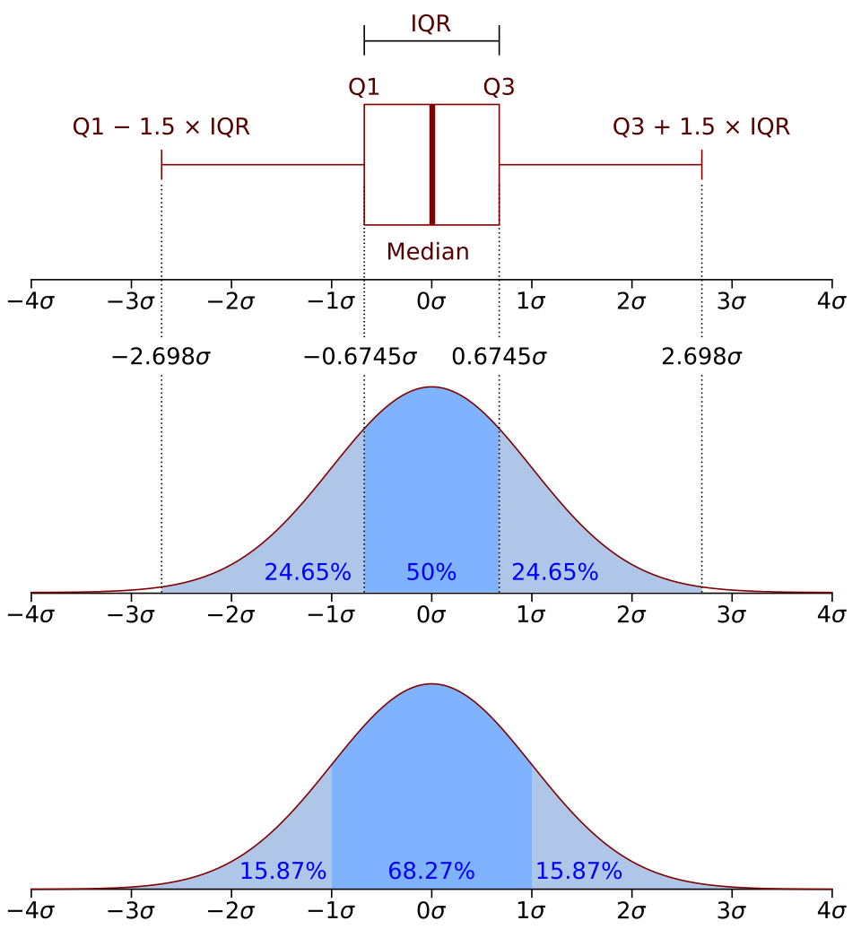
Data Cleaning – Handle Outlier
Q1 = df_cleaned.quantile(0.25)
Q3 = df_cleaned.quantile(0.75)
IQR = Q3 - Q1
outliers = ((df_cleaned < (Q1 - 1.5 * IQR)) | (df_cleaned > (Q3 + 1.5 * IQR))).sum()
print("Number of outliers per feature:")
print(outliers)
Handle Outlier Code

Slide 17
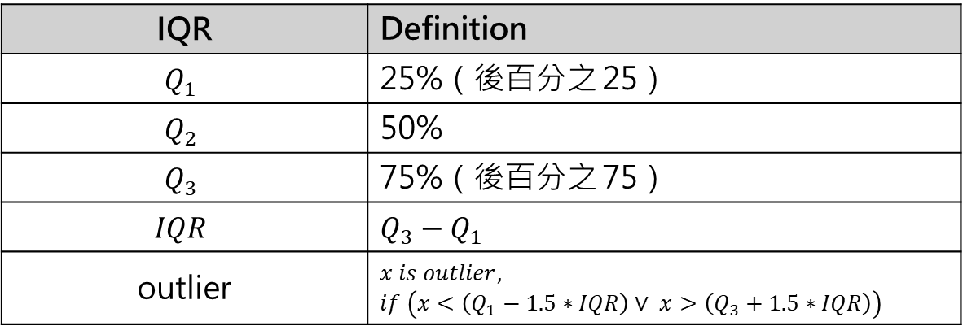
Data Cleaning – Handle Outlier
Q1 = df_cleaned.quantile(0.25)
Q3 = df_cleaned.quantile(0.75)
IQR = Q3 - Q1
outliers = ((df_cleaned < (Q1 - 1.5 * IQR)) | (df_cleaned > (Q3 + 1.5 * IQR))).sum()
print("Number of outliers per feature:")
print(outliers)
Handle Outlier Code
IQR | Definition
$$Q_{1}$$ | 25%（後百分之 25）
$$Q_{2}$$ | 50%
$$Q_{3}$$ | 75%（後百分之 75）
$$IQR$$ | $$Q_{3}−Q_{1}$$
outlier | $$x is outlier, \\ if \left(x<\left(Q_{1}−1.5∗IQR\right)∨ x>\left(Q_{3}+1.5∗IQR\right)\right)$$

Slide 18
Data Cleaning – Handle Outlier
Q1 = df_cleaned.quantile(0.25)
Q3 = df_cleaned.quantile(0.75)
IQR = Q3 - Q1
outliers = ((df_cleaned < (Q1 - 1.5 * IQR)) | (df_cleaned > (Q3 + 1.5 * IQR))).sum()
print("Number of outliers per feature:")
print(outliers)
Handle Outlier Code
Outlier Per Feature | Outliers
fixed acidity | 41
volatile acidity | 19
citric acid | 1
residual sugar | 126
chlorides | 87
free sulfur dioxide | 26
total sulfur dioxide | 45
density | 35
pH | 28
sulphates | 55
alcohol | 12
quality | 27

Slide 19
Data Cleaning – Handle Outlier
Q1 = df_cleaned.quantile(0.25)
Q3 = df_cleaned.quantile(0.75)
IQR = Q3 - Q1
outliers = ((df_cleaned < (Q1 - 1.5 * IQR)) | (df_cleaned > (Q3 + 1.5 * IQR))).sum()
print("Number of outliers per feature:")
print(outliers)
Handle Outlier Code
Outlier Per Feature | Outliers
fixed acidity | 41
volatile acidity | 19
citric acid | 1
residual sugar | 126
chlorides | 87
free sulfur dioxide | 26
total sulfur dioxide | 45
density | 35
pH | 28
sulphates | 55
alcohol | 12
quality | 27
最終選擇保留 Outlier
如果將 Outlier 全部刪除可能造成 Dataset 過少
在 red wine Dataset 中，部分 Outlier 可能代表 quality 好的酒

Slide 20

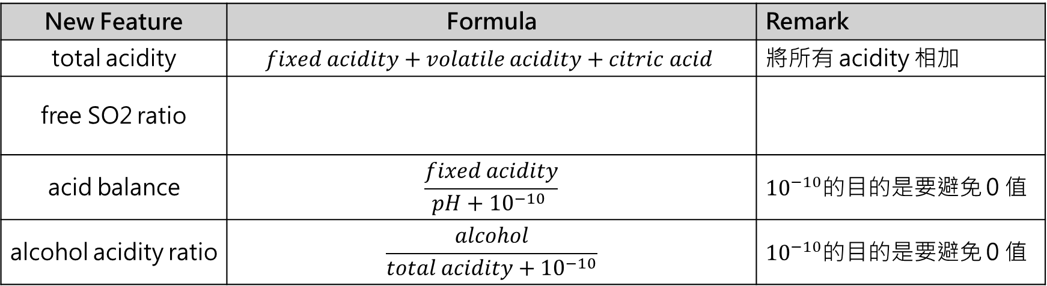
Feature Engineering
Feature Engineering 的目的是透過原本的 Feature 再增加一些有相關的 Features
=> 除了原本的 12 個 Feature 再增加 4 個 Feature
New Feature | Formula | Remark
total acidity | $$fixed acidity+volatile acidity+citric acid$$ | 將所有 acidity 相加
free SO2 ratio
acid balance | $$\frac{fixed acidity}{pH+{10}^{−10} }$$ | ${10}^{−10}$的目的是要避免 0 值
alcohol acidity ratio | $$\frac{alcohol}{total acidity+{10}^{−10}}$$ | ${10}^{−10}$的目的是要避免 0 值

Slide 21
Feature Engineering
def feature_engineering(df):
"""
Feature Engineering
Create new features based on wine chemistry knowledge
"""
print("\n=== Feature Engineering ===")
df_engineered = df.copy()
# 1. Create total acidity feature
Create Total Acidity Feature Code
# 2. Create SO2 ratio feature
Create Free SO2 Ratio Feature Code
# 3. Create acid-base balance feature
Create Acid Balance Code
# 4. Create alcohol to acidity ratio
Create Alcohol Acidity Ratio Code
print(f"After feature engineering, data shape: {df_engineered.shape}")
print(f"Number of new features: {len(df_engineered.columns) - len(df.columns)}")
return df_engineered
之前的 Data shape: (1599, 12)
Result: After feature engineering, data shape: (1359, 16)
12+4 = 16

Slide 22
Feature Engineering
df_engineered['total_acidity'] = (
df_engineered['fixed acidity'] +
df_engineered['volatile acidity'] +
df_engineered['citric acid']
)
Create Total Acidity Feature Code
df_engineered['free_SO2_ratio'] = (
df_engineered['free sulfur dioxide'] /
df_engineered['total sulfur dioxide']
)
# Handle division by zero errors
df_engineered['free_SO2_ratio'] = df_engineered['free_SO2_ratio'].replace([np.inf, -np.inf], np.nan)
df_engineered['free_SO2_ratio'] = df_engineered['free_SO2_ratio'].fillna(0)
Create Free SO2 Ratio Feature Code
df_engineered['acid_balance'] = (
df_engineered['fixed acidity'] /
(df_engineered['pH'] + 1e-10) # Avoid division by zero
)
Create Acid Balance Code
df_engineered['alcohol_acidity_ratio'] = (
df_engineered['alcohol'] /
(df_engineered['total_acidity'] + 1e-10)
)
Create Alcohol Acidity Ratio Code

Slide 23
Feature Selection
Correlation 會計算兩組之間的相關性
如計算 quality 與 alcohol 的相關性
Correlation 介在 [-1 ~ 1] 之間愈靠近 1 代表愈正相關，反之靠近 -1 代表愈負相關
def select_features(df, target_column='quality'):
"""
Feature Selection
Use correlation analysis and domain knowledge to select important features
"""
print("\n=== Feature Selection ===")
# Calculate correlation with target variable
correlation = df.corr()[target_column].abs().sort_values(ascending=False)
print("Feature correlation with target variable (quality):")
print(correlation)
# Visualize correlation matrix
Draw Correlation Matrix
# Select features based on correlation (threshold can be adjusted)
# Here we select features with correlation greater than 0.05
selected_features = correlation[correlation > 0.1].index.tolist()
selected_features.remove(target_column) # Remove target variable
print(f"\nSelected {len(selected_features)} features:")
print(selected_features)
return selected_features
計算 quality 與其他 Features 之間的 Correlation
得出結果後取絕對值並且由大到小排序
threshold 可以自行調整，這邊只保留與 quality Correlation > 0.1 的 Features，並且轉成 list
list 中將 quality 刪除（因為 quality 是 Target）

Slide 24
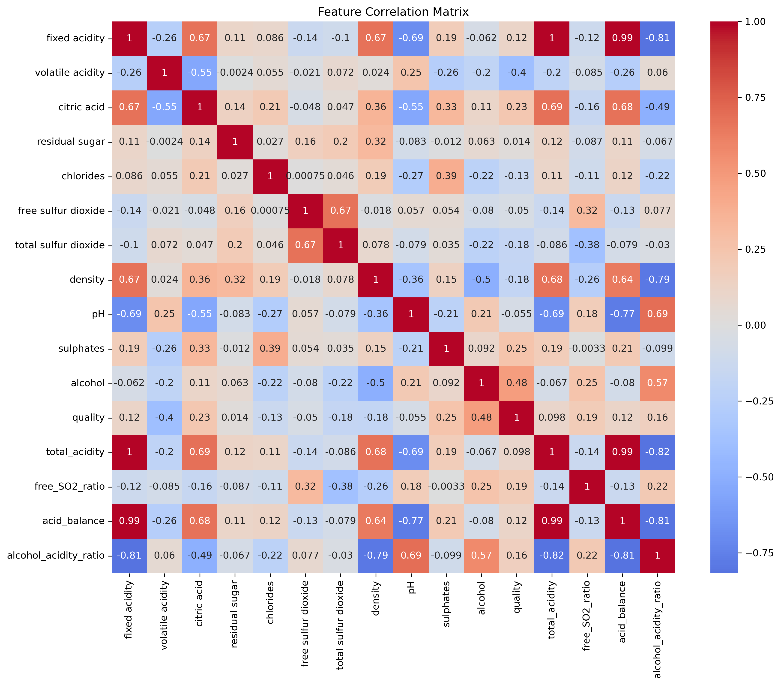
Feature Selection
取出來的 quality 與其他 Features 間的 Correlation
.abs().sort_values(ascending=False)
Quality and Others Correlation | Correlation
quality | 1.000000
alcohol | 0.480343
volatile acidity | 0.395214
sulphates | 0.248835
citric acid | 0.228057
free_SO2_ratio | 0.192296
density | 0.184252
total sulfur dioxide | 0.177855
alcohol_acidity_ratio | 0.158508
chlorides | 0.130988
fixed acidity | 0.119024
acid_balance | 0.115201
total_acidity | 0.097936
pH | 0.055245
free sulfur dioxide | 0.050463
residual sugar | 0.013640
df.corr()[target_column]

Slide 25
Feature Selection
取出來的 quality 與其他 Features 間的 Correlation
Quality and Others Correlation | Correlation
quality | 1.000000
alcohol | 0.480343
volatile acidity | 0.395214
sulphates | 0.248835
citric acid | 0.228057
free_SO2_ratio | 0.192296
density | 0.184252
total sulfur dioxide | 0.177855
alcohol_acidity_ratio | 0.158508
chlorides | 0.130988
fixed acidity | 0.119024
acid_balance | 0.115201
total_acidity | 0.097936
pH | 0.055245
free sulfur dioxide | 0.050463
residual sugar | 0.013640
selected_features = correlation[correlation > 0.1]
（只保留 > 0.1，代表<= 0.1 全部刪除）

Slide 26
Feature Selection
取出來的 quality 與其他 Features 間的 Correlation
Quality and Others Correlation | Correlation
quality | 1.000000
alcohol | 0.480343
volatile acidity | 0.395214
sulphates | 0.248835
citric acid | 0.228057
free_SO2_ratio | 0.192296
density | 0.184252
total sulfur dioxide | 0.177855
alcohol_acidity_ratio | 0.158508
chlorides | 0.130988
fixed acidity | 0.119024
acid_balance | 0.115201
total_acidity | 0.097936
pH | 0.055245
free sulfur dioxide | 0.050463
residual sugar | 0.013640
.index.tolist()
（將保留的轉成 list）
selected_features = correlation[correlation > 0.1]
（只保留 > 0.1，代表<= 0.1 全部刪除）

Slide 27
Feature Selection
取出來的 quality 與其他 Features 間的 Correlation
Quality and Others Correlation | Correlation
quality | 1.000000
alcohol | 0.480343
volatile acidity | 0.395214
sulphates | 0.248835
citric acid | 0.228057
free_SO2_ratio | 0.192296
density | 0.184252
total sulfur dioxide | 0.177855
alcohol_acidity_ratio | 0.158508
chlorides | 0.130988
fixed acidity | 0.119024
acid_balance | 0.115201
total_acidity | 0.097936
pH | 0.055245
free sulfur dioxide | 0.050463
residual sugar | 0.013640
selected_features.remove(target_column)
（quality 本身並非 Features 所以要移除）
.index.tolist()
（將保留的轉成 list）
selected_features = correlation[correlation > 0.1]
（只保留 > 0.1，代表<= 0.1 全部刪除）

Slide 28
Feature Selection
取出來的 quality 與其他 Features 間的 Correlation
Quality and Others Correlation | Correlation
quality | 1.000000
alcohol | 0.480343
volatile acidity | 0.395214
sulphates | 0.248835
citric acid | 0.228057
free_SO2_ratio | 0.192296
density | 0.184252
total sulfur dioxide | 0.177855
alcohol_acidity_ratio | 0.158508
chlorides | 0.130988
fixed acidity | 0.119024
acid_balance | 0.115201
total_acidity | 0.097936
pH | 0.055245
free sulfur dioxide | 0.050463
residual sugar | 0.013640
最終 selected_feature 的 list 所保留的 11 個 Features

Slide 29
Feature Scaling, Standardization
def scale_features(df, features, target_column='quality'):
print("Standardization Features:\n", features)
"""
Feature Scaling
Use standardization (Z-score normalization) to make features have zero mean and unit variance
"""
print("\n=== Feature Scaling ===")
# Separate features and target
X = df[features]
print("Standardization X:\n",X)
y = df[target_column]
# Initialize scaler
scaler = StandardScaler()
# Fit and transform features
X_scaled = scaler.fit_transform(X)
print("Standardization X_scaled:\n",X_scaled)
# Create new DataFrame
X_scaled_df = pd.DataFrame(X_scaled, columns=features)
print("Scaling completed!")
print("Statistical summary after scaling:")
print(pd.DataFrame(X_scaled_df).describe().loc[['mean', 'std']])
return X_scaled_df, y, scaler
features 是已經經過 Feature Selection 處理過的 Feature
X 是將指定 features 的 dataframe 取出
y 是將指定 quality 的 dataframe 取出
將 X 中所有值透過 Standardization 轉為差距不會太大的區間
（因為每一個 Feature 的區間都不一樣，可能會使 model 在 Gradient Descent 難以收斂）
x_scaled 的 type 是 list
x_scaled_df 是將 x_scaled 是轉為 dataframe

Slide 30
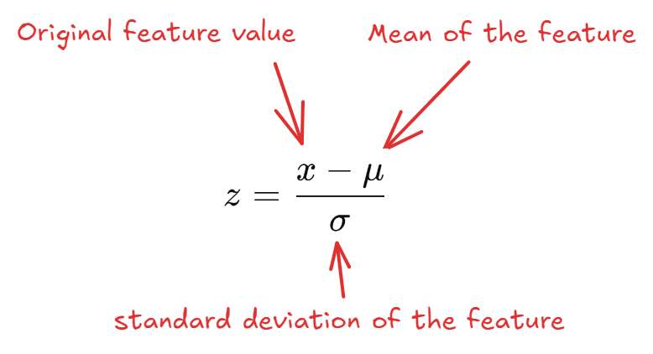
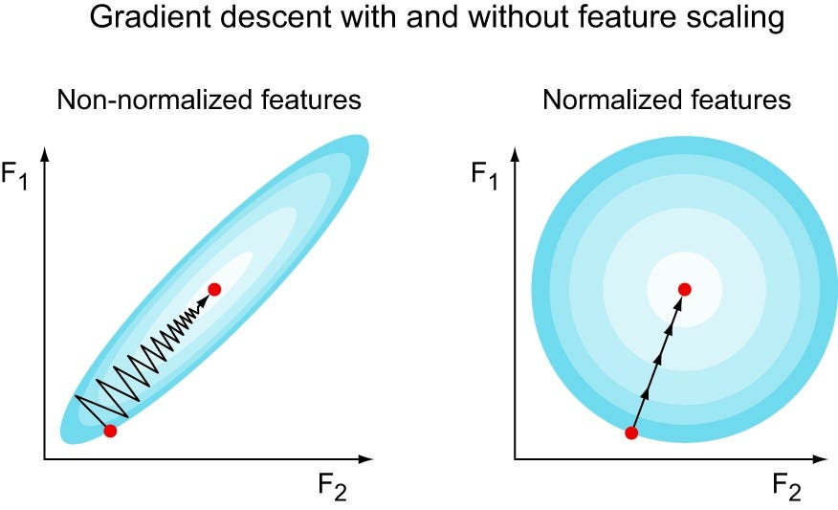
Feature Scaling, Standardization
Standardization 又稱為 Z-score Normalization

Slide 31
Feature Scaling, Standardization
alcohol volatile acidity sulphates citric acid ... alcohol_acidity_ratio chlorides fixed acidity acid_balance
0 9.4 0.700 0.56 0.00 ... 1.160494 0.076 7.4 2.108262
1 9.8 0.880 0.68 0.00 ... 1.129032 0.098 7.8 2.437500
2 9.8 0.760 0.65 0.04 ... 1.139535 0.092 7.8 2.392638
3 9.8 0.280 0.58 0.56 ... 0.813953 0.075 11.2 3.544304
Non-Standardization Data
Standardization
alcohol volatile acidity sulphates citric acid ... alcohol_acidity_ratio chlorides fixed acidity acid_balance
0 -0.954374 0.932000 -0.578561 -1.393258 ... -0.108607 -0.245623 -0.524431 -0.682477
1 -0.584575 1.915800 0.124822 -1.393258 ... -0.219785 0.200094 -0.294063 -0.153885
2 -0.584575 1.259934 -0.051024 -1.188617 ... -0.182671 0.078535 -0.294063 -0.225911
3 -0.584575 -1.363534 -0.461331 1.471711 ... -1.333194 -0.265883 1.664067 1.62309
Standardization Data

Slide 32
Data Splitting
def split_data(X, y, test_size=0.2, random_state=42):
"""
Split data into training and testing sets
"""
print("\n=== Data Splitting ===")
X_train, X_test, y_train, y_test = train_test_split(
X, y, test_size=test_size, random_state=random_state, stratify=y
)
print(f"Training set size: {X_train.shape}")
print(f"Testing set size: {X_test.shape}")
print(f"Training set target distribution: \n{y_train.value_counts().sort_index()}")
print(f"Testing set target distribution: \n{y_test.value_counts().sort_index()}")
return X_train, X_test, y_train, y_test
將 Dataset 切割為 Training Set 與 Testing Set
Dataset 切割為 8:2

Slide 33
PCA Applying
def apply_pca(X, n_components=2):
"""
Apply PCA for dimensionality reduction and visualization
"""
print("\n=== PCA Dimensionality Reduction ===")
pca = PCA(n_components=n_components)
X_pca = pca.fit_transform(X)
print(f"Explained variance ratio: {pca.explained_variance_ratio_}")
print(f"Cumulative explained variance ratio: {np.sum(pca.explained_variance_ratio_):.4f}")
return X_pca, pca
PCA 主要目的在做 Dimensionality Reduction
但因為 red wine dataset 的 feature 不多
這裡的目的主要是呈現在圖表上
若 n_components 設定為 2 代表要做 Dimension 要降到 2-dimension

Slide 34
Preprocessing Pipeline
def complete_preprocessing_pipeline(file_path='dataset/winequality-red.csv', test_size=0.2):
# Step 1: Load data
df = load_wine_data(file_path)
if df is None:
return None
# Step 2: Data exploration
df = explore_data(df)
# Step 3: Data cleaning
df_cleaned = clean_data(df)
# Step 4: Feature engineering
df_engineered = feature_engineering(df_cleaned)
# Step 5: Feature selection
selected_features = select_features(df_engineered)
# Step 6: Feature scaling
X_scaled, y, scaler = scale_features(df_engineered, selected_features)
# Step 7: Data splitting
X_train, X_test, y_train, y_test = split_data(X_scaled, y, test_size=test_size)
# Step 8: Optional PCA analysis
X_pca, pca = apply_pca(X_scaled)
# Return all necessary results
Necessary Dictionary Code
return results

Slide 35
PreProcessing Pipeline
沒有命名的 Edges 表示為來自上一個 State 所產生的 Dataframe
data cleaning
data exploration
dataset: winequality-red.csv
data loading
check duplicate
feature engineering
check missing value
check outlier
feature selection
(Correlation)
result
PCA applying
data splitting
(Training Set and Testing Set)
feature scaling
(Normalization or Stradardization)

